Slide 1
Final Demo
Junzhe Tan; Mutian Yuan
Electrical Engineering students
ESE 5750
Notes:
Opening Slide (with Footer)

Slide 2
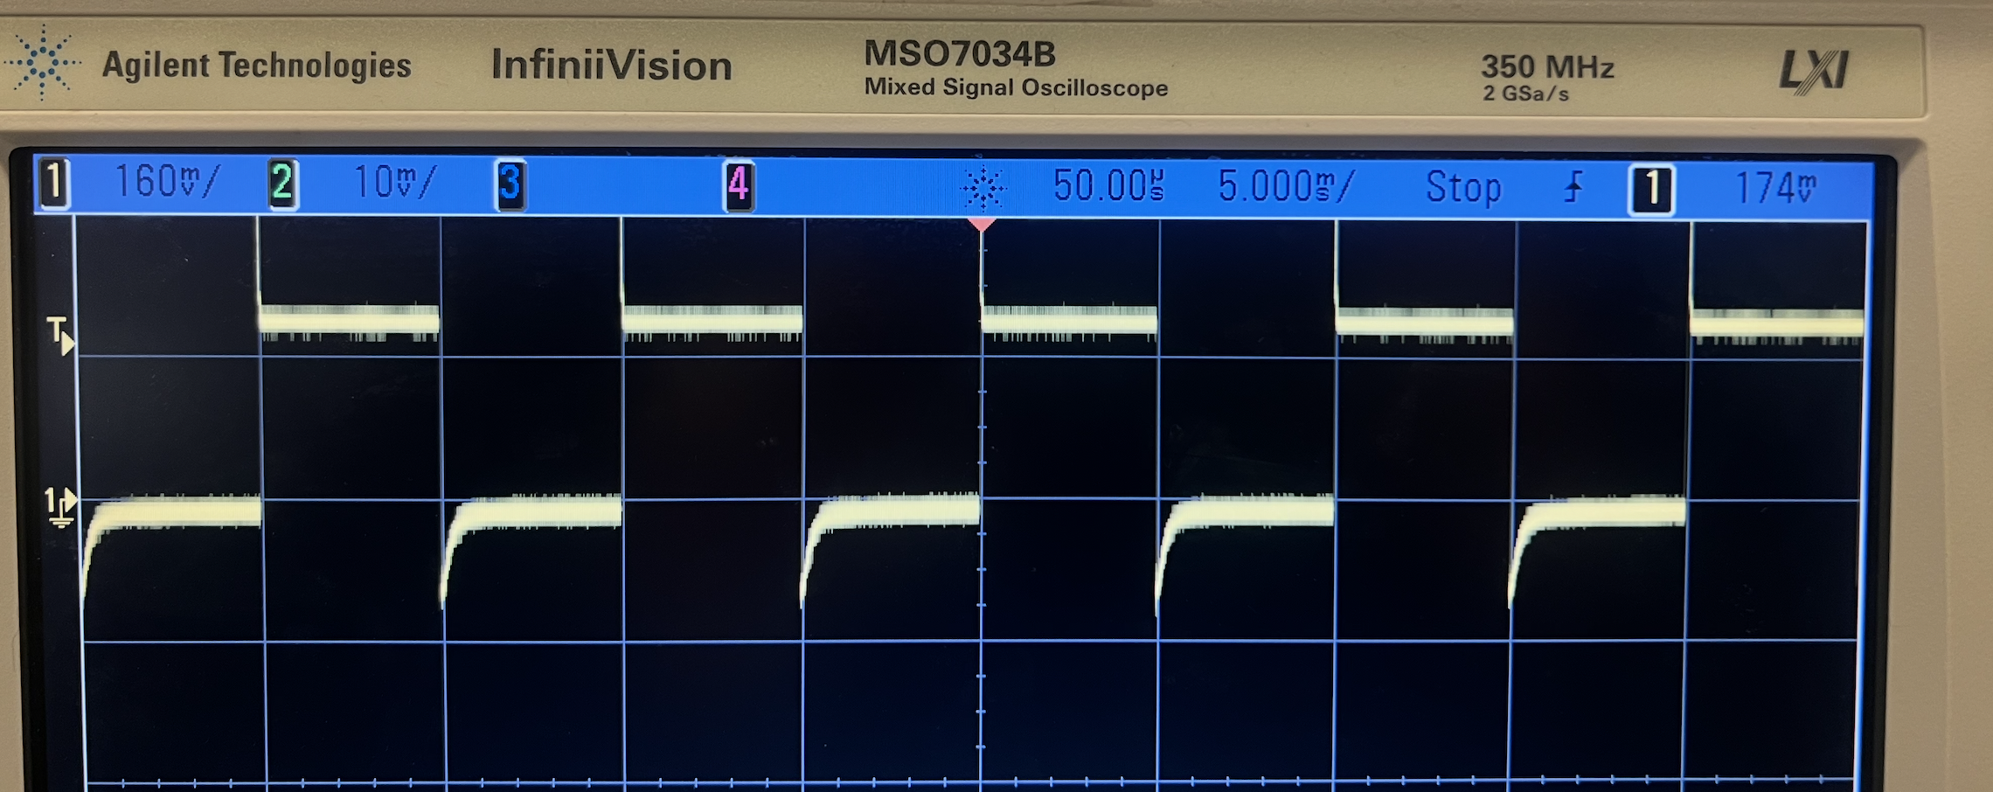
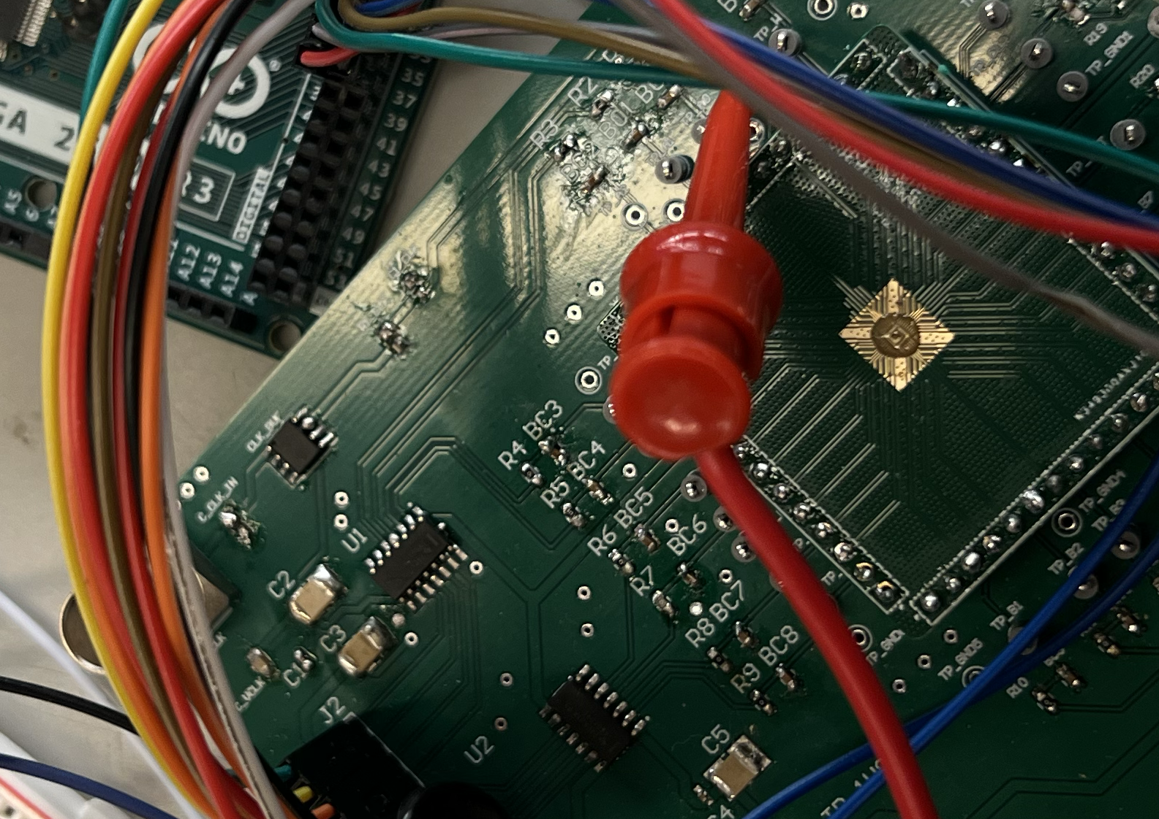
PCB Problem
The Buffer can not filter the overshoot ideally
The Buffer output voltage is very low, only 0.17 V
Concerning this, we directly connect the clock signal to the testpoint.
Notes:
Divider Slide or image callout slide, with line drawings. Line drawings are copy/pasted into presentation and can be easily removed. To replace photo, right-click and select “change picture”/ To recrop, right-click and select “crop”.

Slide 3
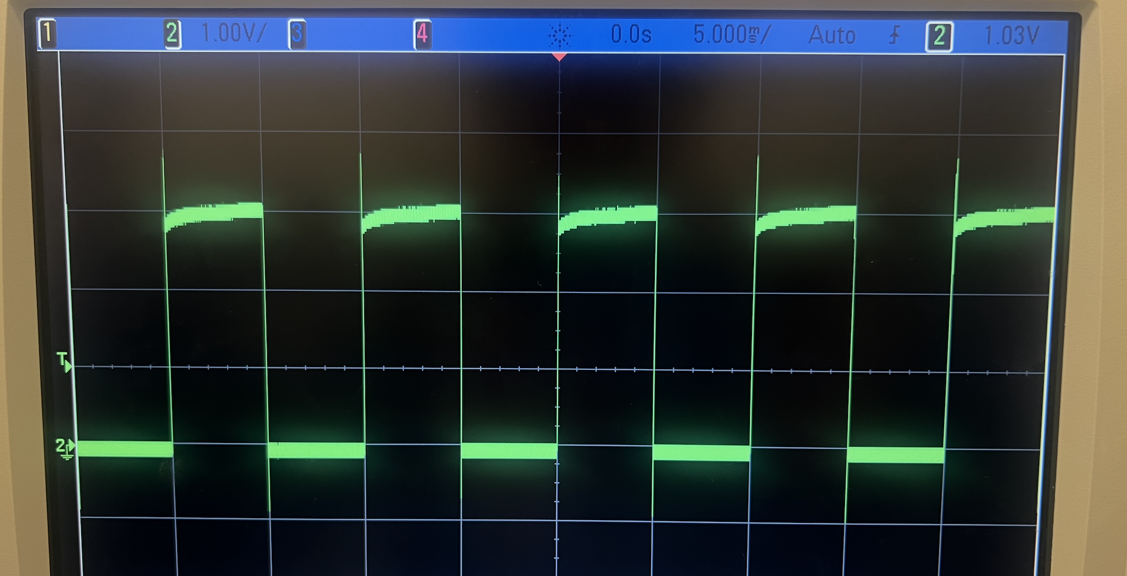
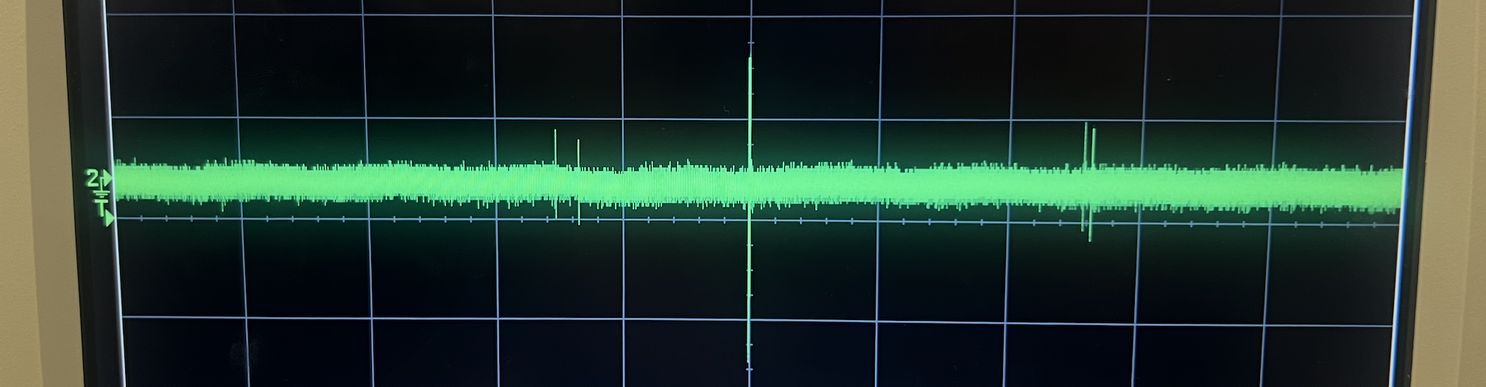
PCB Problem
Still Overshoot:
may result in chip damage
Especially when the CLK signal just come in, without the coupling capacitor, the overshoot can not be avoid, and the extra LC on the bonding wire may also cause extra error.
The CLK vary from 0-1.8 V
Notes:
Divider Slide or image callout slide, with line drawings. Line drawings are copy/pasted into presentation and can be easily removed. To replace photo, right-click and select “change picture”/ To recrop, right-click and select “crop”.

Slide 4
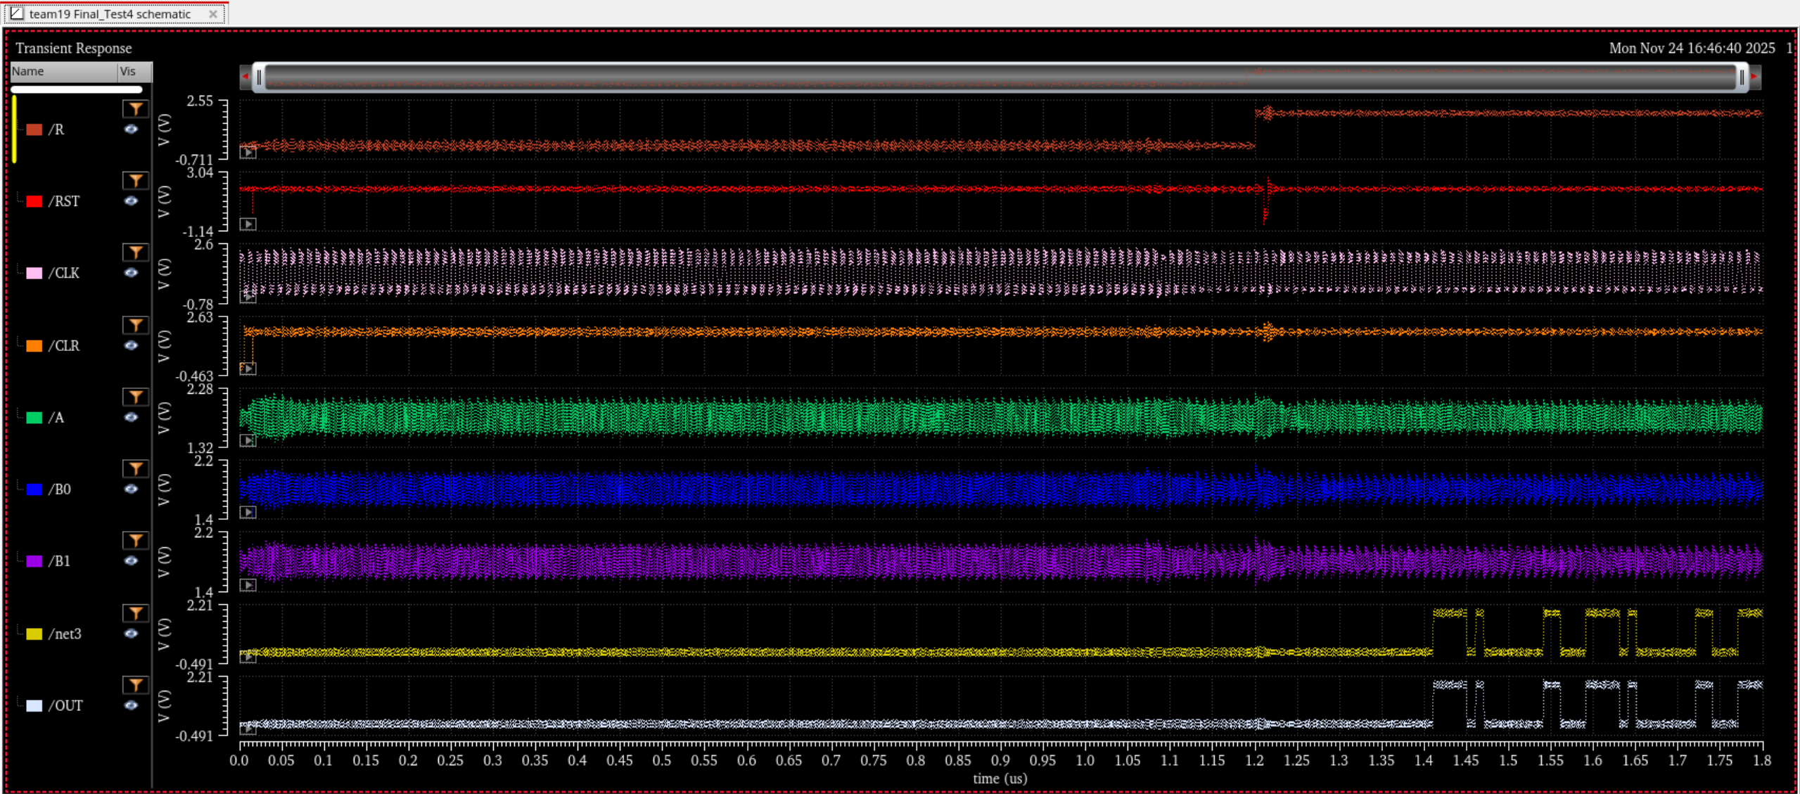
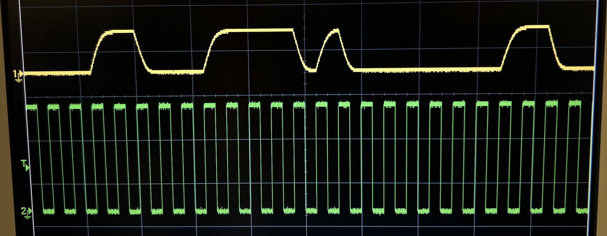
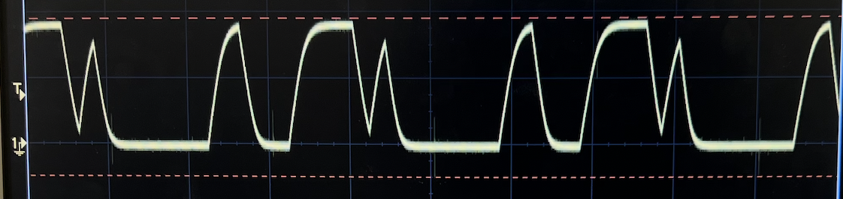
Test Result
Correct Results!
All data signal A0-A7, B0-B7 are 1
Simulation
Results
500 Hz CLK signal
The CLK vary from 0-1.8 V
1 kHz CLK signal
Notes:
Divider Slide or image callout slide, with line drawings. Line drawings are copy/pasted into presentation and can be easily removed. To replace photo, right-click and select “change picture”/ To recrop, right-click and select “crop”.

Slide 5
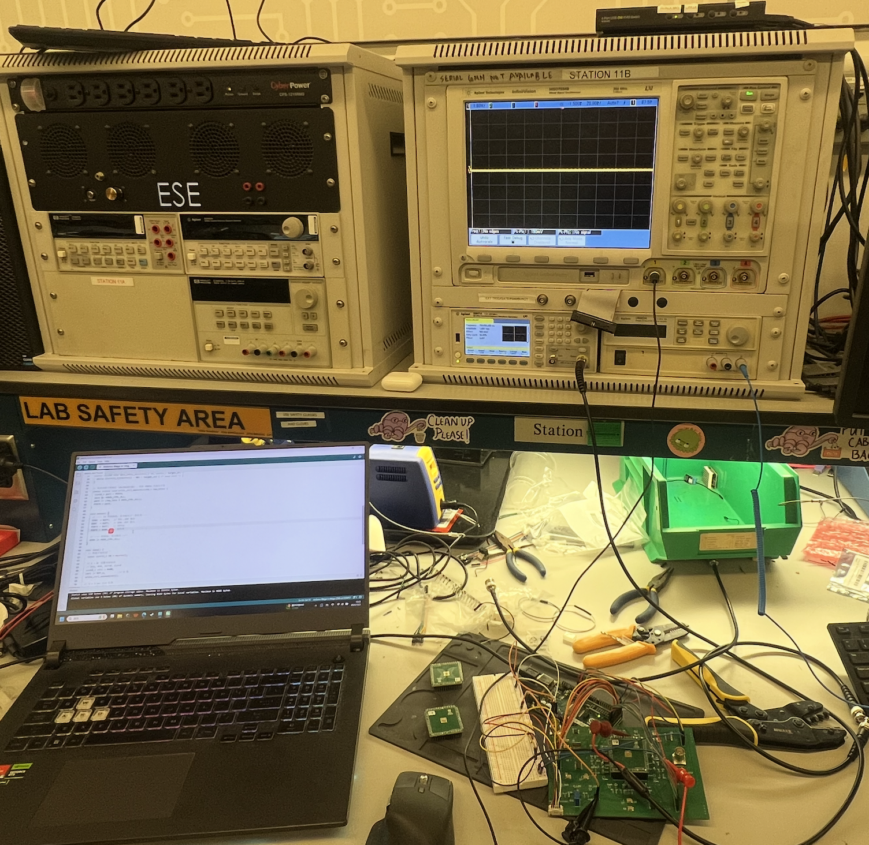
Test Result
Correct Results!
All data input are 0
100 Hz CLK signal
Notes:
Divider Slide or image callout slide, with line drawings. Line drawings are copy/pasted into presentation and can be easily removed. To replace photo, right-click and select “change picture”/ To recrop, right-click and select “crop”.

Slide 6
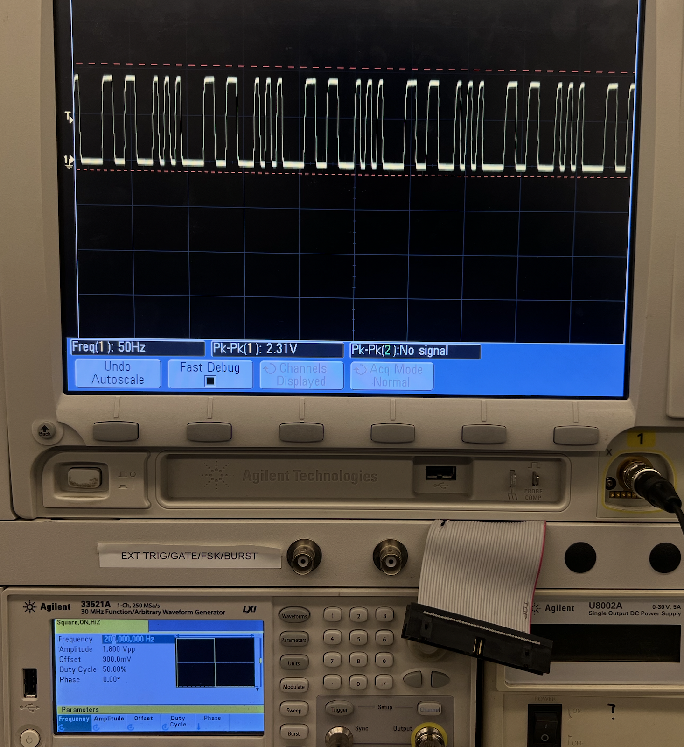
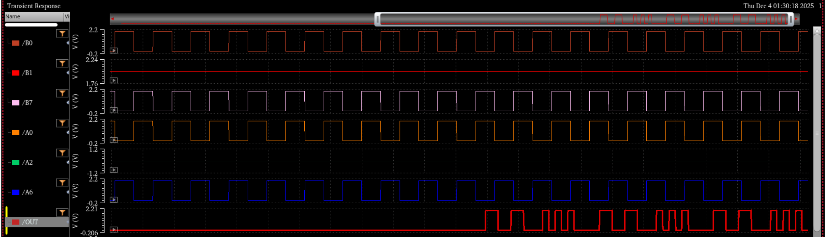
Test Result
Correct Results!
200 Hz CLK signal
During the short period that the chip can work, we also designed a set of random numbers as the input.
For A[7:0]: 1100 0000 and 0000 0011
For B[7:0]: 0101 0111 and 1111 0100
Thus the results should be:
1100 0000 * 0101 0111 + 0000 0011 * 1111 0100 + 1100 0000 * 0101 0111 + 0000 0011 * 1111 0100 + 1100 0000 * 0101 0111 + 0000 0011 * 1111 0100 =
1100 1100 0101 0100
As can be seen below, We can obtain the same and correct values in simulation and test.
Notes:
Divider Slide or image callout slide, with line drawings. Line drawings are copy/pasted into presentation and can be easily removed. To replace photo, right-click and select “change picture”/ To recrop, right-click and select “crop”.

Slide 7
Thank you! Q&A

